Slide 1
Functions in R

Slide 2
Functional programming → Advantages why do we wan to use it?
Functional programming can be beneficial in R for several reasons:
Thanks to Functional programming we can write more concise and readable code
Functional programming encourages the use of reusable code blocks in the form of functions. This can make your code more modular and easier to maintain
Functional programming reduce the likelihood of errors due to code duplication
Helps with Debugging

Slide 3
Syntax
name_of_function <- function(arguments){
>> do the math here using arguments <<
return(result_of_doing_math_back_there)
}
return returns to global environment the specified value.
it is not necessary to use it but recommended as it is more elegant!!!

Slide 4
How to return many objects in R as a function output?
How to return single object in R as a function output?
my_function <- function(x) {
y <- x * 2
z <- x + 3
return(list(y, z))
}
my_function <- function(x) {
y <- x * 2
z <- x + 3
return(z)
}

Slide 5
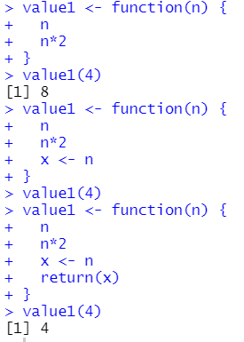
Why return of the function is so important?
The return statement in a function is important because it specifies the value that the function should output or return to the calling code.
Without the return statement, the function would still execute its code but if the last line is a assign variable then nothing will be returned!!!
As the last line is assigning a variable without return nothing will be return to global environment once the function is called!!!

Slide 6
Defensive programming
Defensive programming is a In R, defensive programming can be particularly important because R is an interpreted programming technique that aims to reduce the likelihood of bugs and errors by anticipating potential problems and incorporating error handling and defensive checks into the code.
Input validation: Before processing any input data, it is important to validate the data to ensure that it is in the expected data type and within the expected range of values. For example, if a function expects a numeric input, it should check that the input is a numeric type and that it is within a reasonable range of values.
Error handling: It is important to include error handling in your code to detect and handle unexpected conditions that may occur during the execution of the code. This can include using try-catch statements to handle errors or incorporating code to log errors and notify the user of unexpected results.
Defensive coding: For example, you can use conditional statements and defensive checks to ensure that your code behaves correctly in unexpected situations.

Slide 7
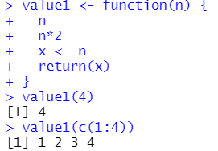
R is vectorized!!!!

Slide 8
Types of arguments in R
Required arguments: These are arguments that must be included when calling the function and have no default value. If a required argument is not provided, an error will occur.
Optional arguments: These are arguments that are not required and have default values. If a value is not provided for an optional argument, the default value will be used.
Default arguments: These are arguments that have default values and are not required to be specified when calling the function. If a value is not provided for a default argument, the default value will be used.
Understanding the different types of arguments in R can be helpful when writing functions or working with existing functions, as it can help you understand how to call a function correctly and what types of inputs are expected.

Slide 9
Lazy evaluation
n R, lazy evaluation is a feature of the language that delays the evaluation of an expression until its value is actually needed. This means that expressions are not immediately evaluated when they are assigned to a variable or passed as an argument to a function. Instead, the expression is stored as a promise, which is essentially a placeholder for the value of the expression.
When the value of the expression is needed (for example, when it is printed to the console or used in a calculation), the promise is forced and the expression is evaluated. This can help improve the performance of R code, especially when dealing with large datasets or complex computations, as it avoids unnecessary computations.

Slide 10
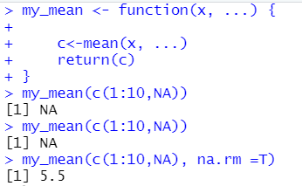
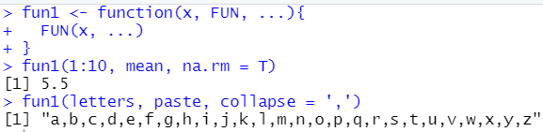

Function wrapper … and FUN
… → allow for additional parameters, any parameters in spot where you put it.
FUN → as function can be an argument of another function we
specify that using FUN (argument is another function (used in apply family))

Slide 11
Some remarks
Why return is important?
If we do not specify what we want to return R will return the last used value
How to return many elements?
Using list
How to retrieve values from a list?
Vectorization in functions
Error handling, defensive programming – next class

Slide 12
Parameters of the functions
Parameters of the functions:
Can be varied
Can be constant
Can be null
unlimited list of parameters → …
Lazy programming
Example with ggplot

Slide 13
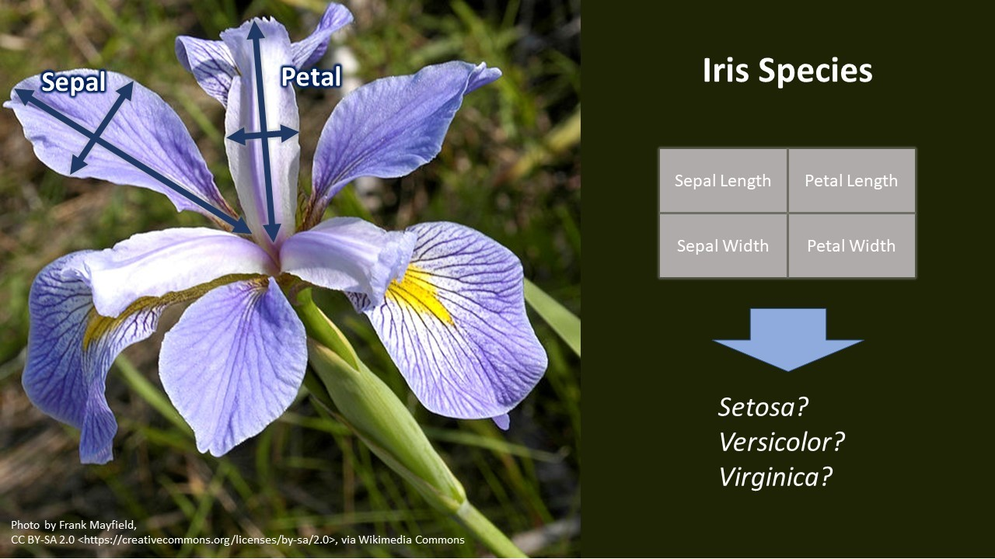

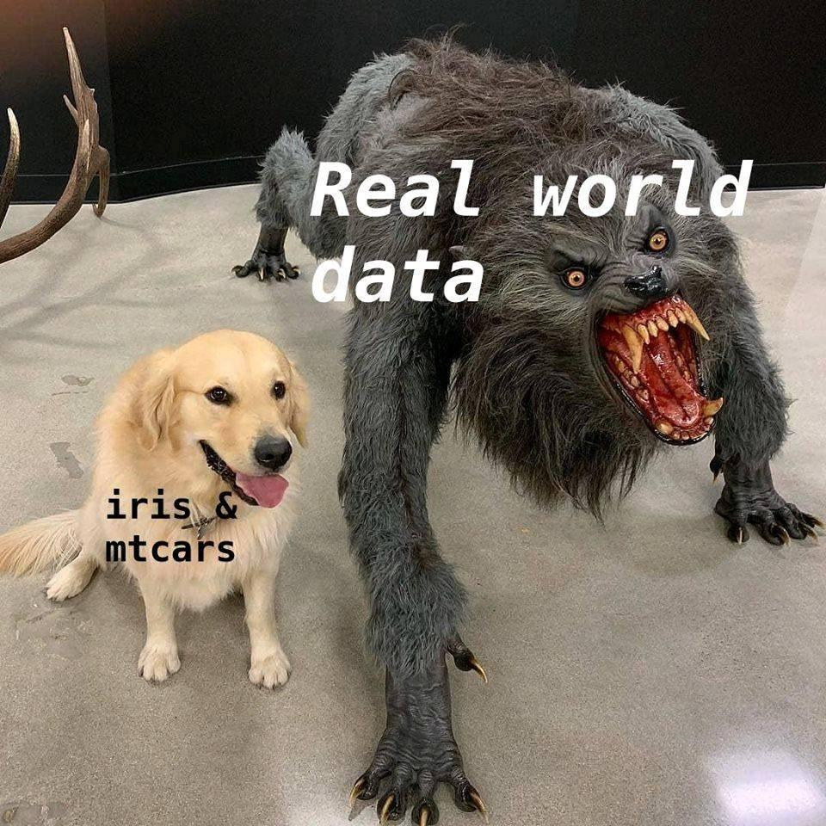
Iris data

Slide 14
Statistical book recommendation
Summary and Analysis of Extension Program Evaluation in R
Salvatore S. Mangiafico
https://rcompanion.org/handbook/index.html

